Slide 1
CSA and timings
Luca Terenzi

Slide 2
Grouping algorithm Overview
In our detector we will collect data regarding each interaction in terms of deposited energy, time stamp and position (E,t,x,y,z). However, we do not know which interactions belong to which event chain. For this it is important to devise al algorithm capable of sorting what interaction belongs to which.
Ideally, since the space of collected interaction will be very big, it is virtually impossible to search the whole space every time we attempt to make a grouping. For this reason, the algorithm will necessitate of two parts:
A first way to divide the whole space into a subset of interaction
An algorithm and/or likelihood function to group the interactions

Slide 3
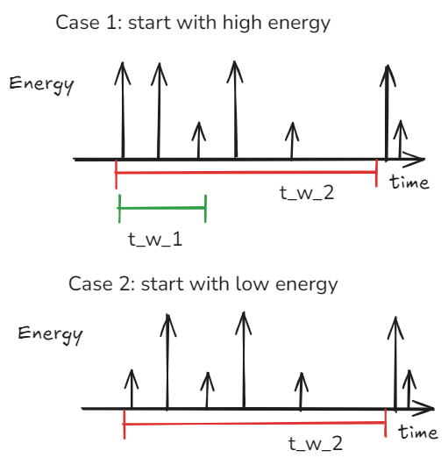
Grouping algorithm version 0
Seeding interaction: the ungrouped interaction with the lowest time stamp is the seed for the group. This means that we will try to group all interactions that belong to the event chain to which also the seed belongs to.
Time window: We know that the time uncertainty on each time stamp is given by both the collection time std (almost constant for all energy, ignore for now) and the time jitter (highly dependent on energy). To select a subset of interaction, we take the seed, check its energy, if it is above 50 kev, then we take two time windows as in case 1. the first is smaller and dictated by 3*jitter at high energies (where it is almost constant), from this we select all interactions. From the second time window (3*jitter) with a bigger jitter for low energy interactions we just take the interaction with energy below 50 kev. Doing so it is very likely to include all interactions belonging to the seed event chain.
NB: unless specified these two previous points will be the same for the other algorithms.
Grouping algorithm: None. In this case we just take all interactions in the union of the the two time windows and assume they belong together. This is kind of the worst algorithm and used just as baseline of the worst we can do with the time window approach described above.

Slide 4
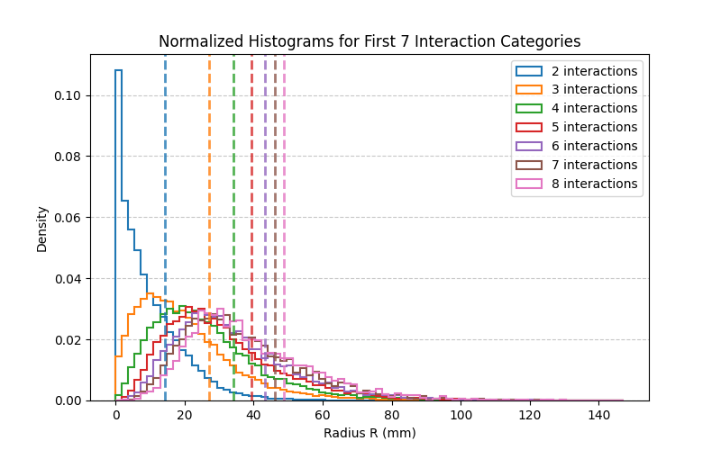
Grouping algorithm version 2
Seeding interaction: as v0
Time window: as v0
Grouping algorithm: Knowing that the detector volume is quite big, and from previous characterization we saw that it is quite unlikely for interaction volumes to intersect each others for different event chains, we characterize the radii distribution of different event chains, grouping them by interaction numbers. Then: start from seed → take closest point → compute radius of interaction volume → if below threshold remove last interaction and stop, otherwise continue.
NB: in this case the threshold was computed as the radius values for the 75th percentile

Slide 5
Grouping algorithm version 3
Seeding interaction: we only seed starting with high energy interactions
Time window: as v0, only case 1, and we search in both directions for 3*jitter, so the time windows become symmetrical around the seed.
Grouping algorithm: same as v2

Slide 6
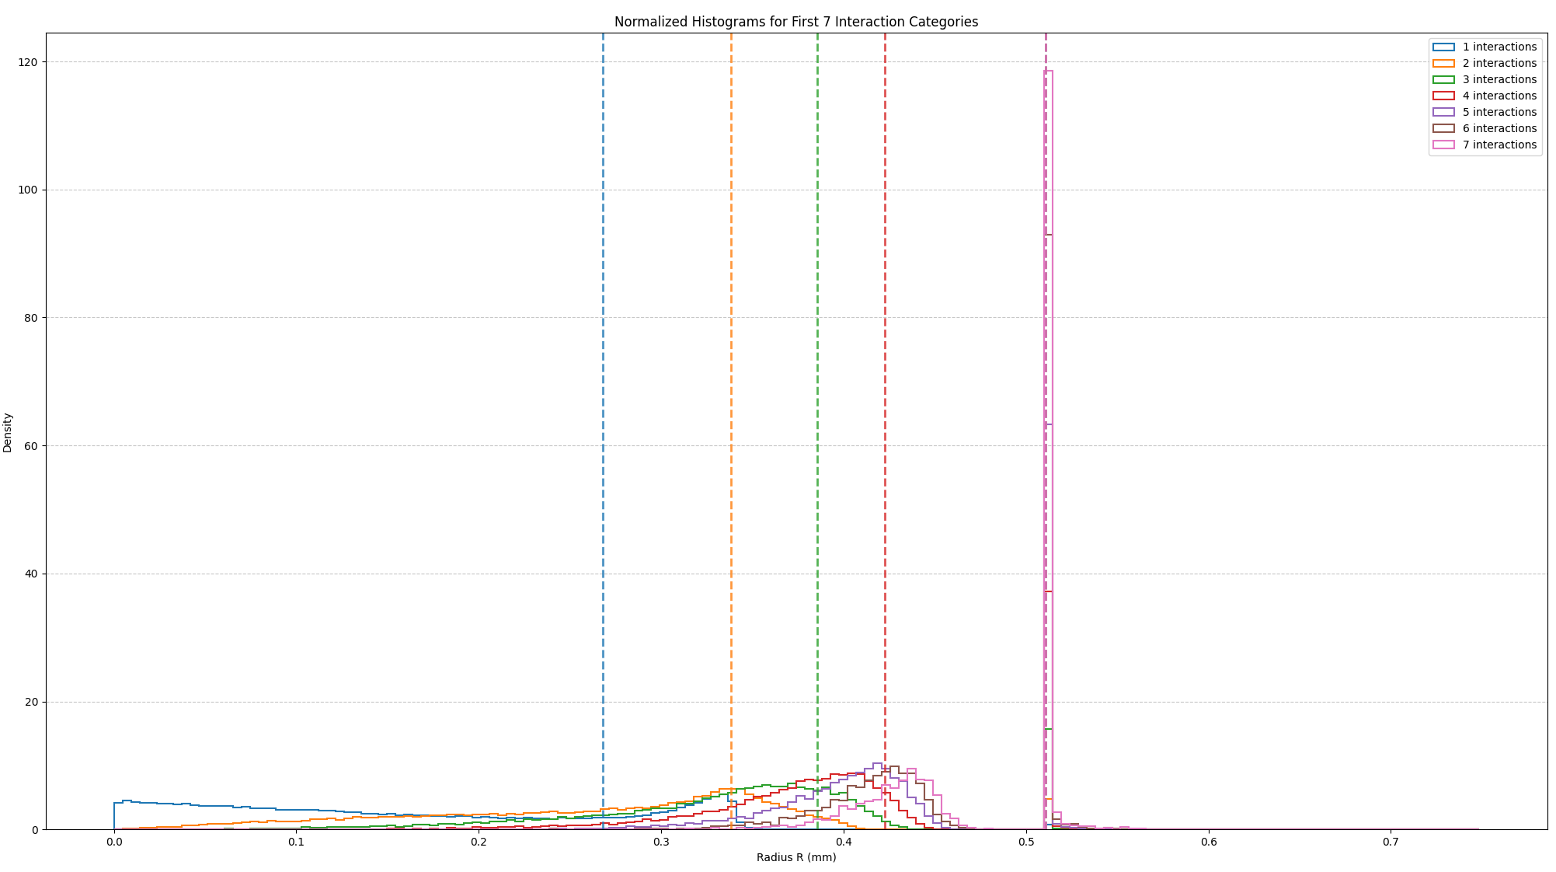
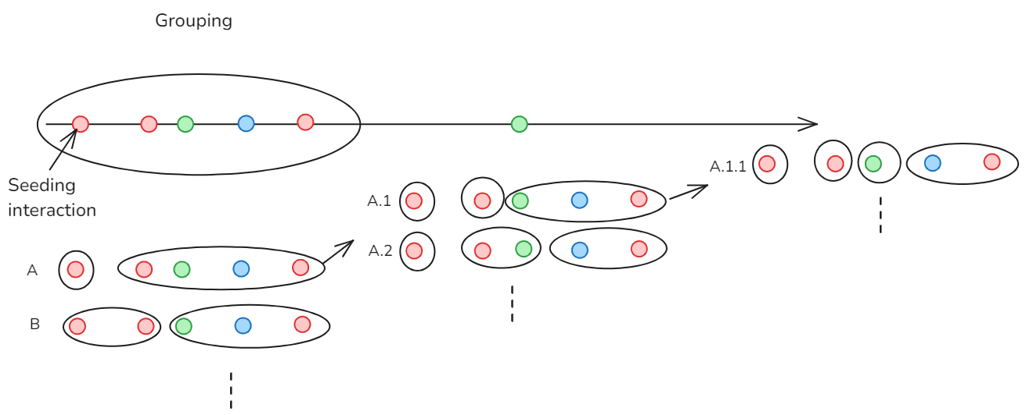
Grouping algorithm version 4.2
Seeding interaction: as v0
Time window: as v0
Grouping algorithm: We use the distributions of radii and energies to compute the likelihood terms associated to both. Then we compute all possible partitions of the interactions inside the time window and sum all the likelihood results that have the same group for the seed interaction (for example A in the image below or B). We then take the one with the highest likelihood as grouping for the seeding interaction.

Slide 7
Grouping algorithm version 4.4
Seeding interaction: as v0
Time window: as v0
Grouping algorithm: We use as for v2 to decide if the seed interaction is on its own or not, and if not we apply likelihood as in v4.2 to determine the likelihood of the possible groups containing the seed interaction and among the results we take the one with the highest likelihood as the correct group. (so no more computing all possible partitions).
NB: this was tried also including a time likelihood depending on jitter and how close in time interactions are among them in the time window

Slide 8
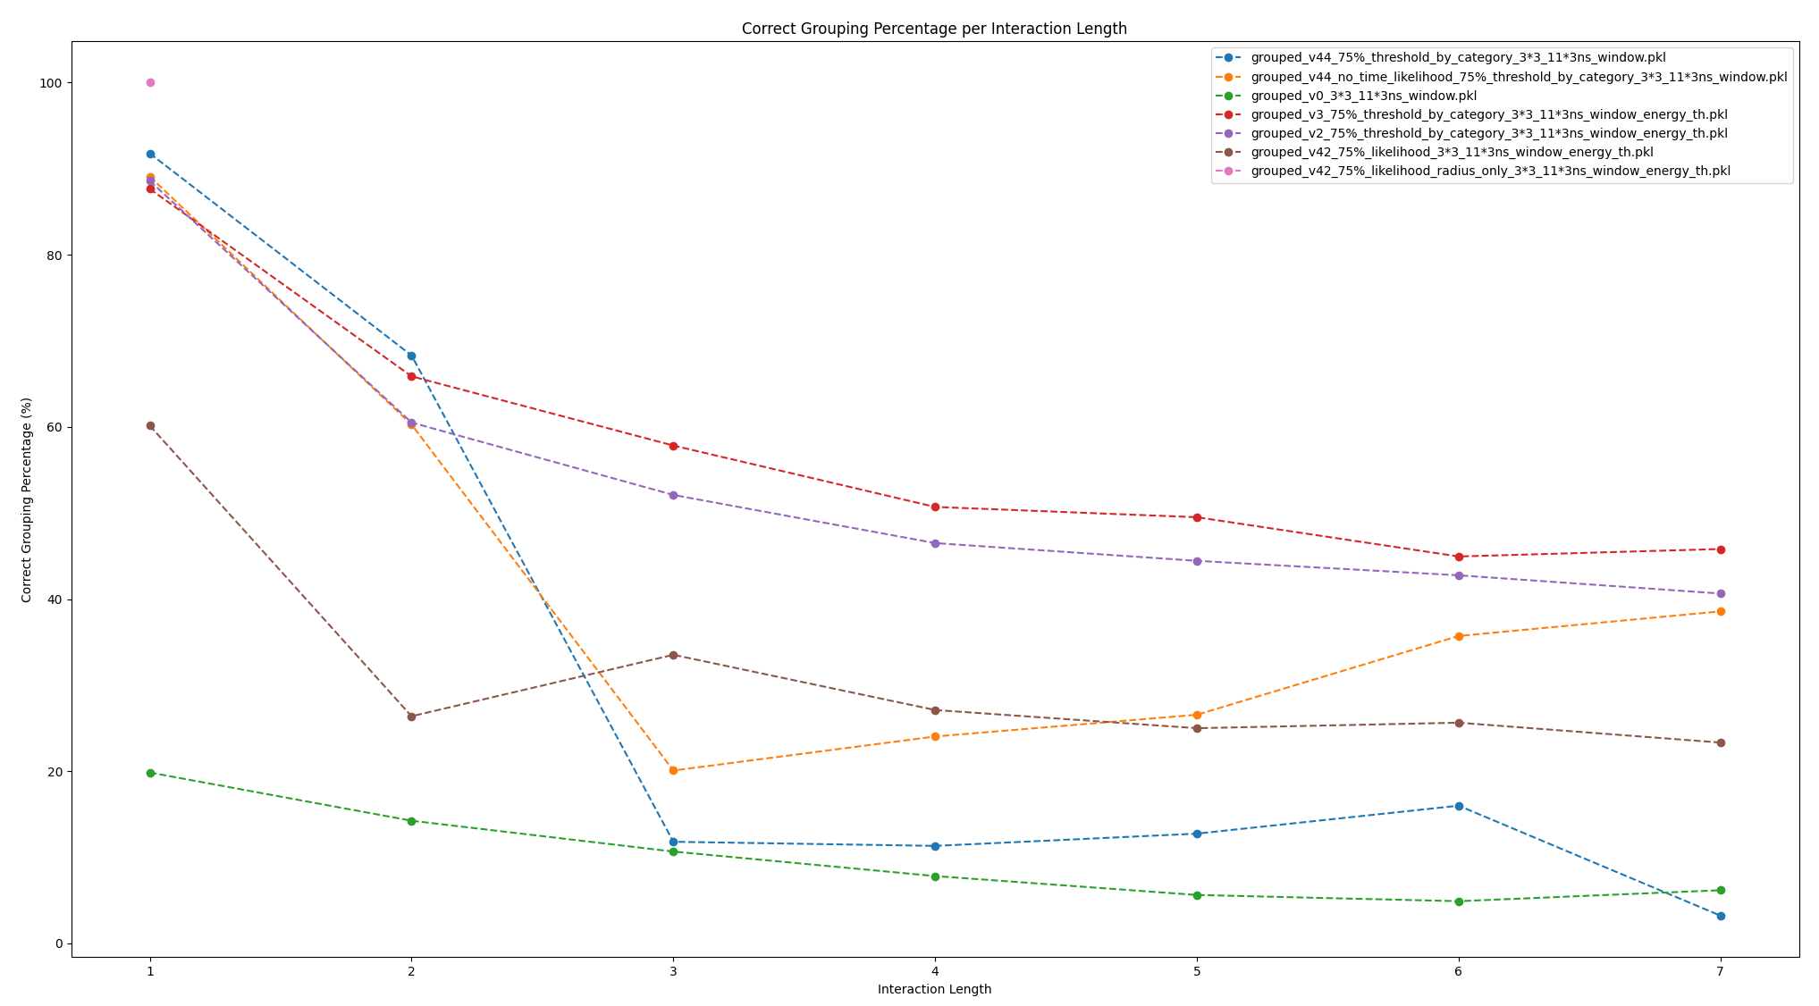
Grouping results accuracy
Version 3 and 2 are overall the best: for now we will use version 2 since for version 3 all the low energy interactions left after grouping the high energy seeds, would reduce the improvement in accuracy so it becomes similar to version 2 at the cost of a longer computation time.
Why are simplified likelihood approaches not working?
The answer seems to be that inherently in the likelihood functions, if we compare the likelihood for 1 interactions with the one for 2 or more, we would have different magnitude in the average likelihood values due to more terms being multiplied. This could be maybe corrected by normalizing the likelihood (maybe using the log likelihood) but so far I could not manage to efficiently do so.
Even with Per likelihood the same problem would persist and if we want to implement it for something like algorithm v2, we would need a threshold to decide when to stop or continue.

Slide 9
Grouping results accuracy

Slide 10
Thank you for your attention!
Any questions?
Notes:
Put notes on all slides that could come often in case of questions like specifics on the experiments or things like that and remove this

